Slide 1
Module 6 Challenge Lab - Creating a VPC Networking Environment for the Cafe
Made for Professor Lanham A. by Amrit Singh

Slide 2
AGENDA
Accessing the AWS management console
Task 1: Creating a public subnet
Task 2: Creating a bastion host
Task 3: Allocating an Elastic IP address for the bastion host
Task 4: Testing the connection to the bastion host
Task 5: Creating a private subnet
Task 6: Creating a NAT gateway
Task 7: Creating an EC2 instance in the private subnet
Task 8: Configuring your SSH client for SSH passthrough
Task 9: Testing the SSH connection from the bastion host
Task 10: Creating a network ACL
Task 11: Testing your custom network ACL

Slide 3
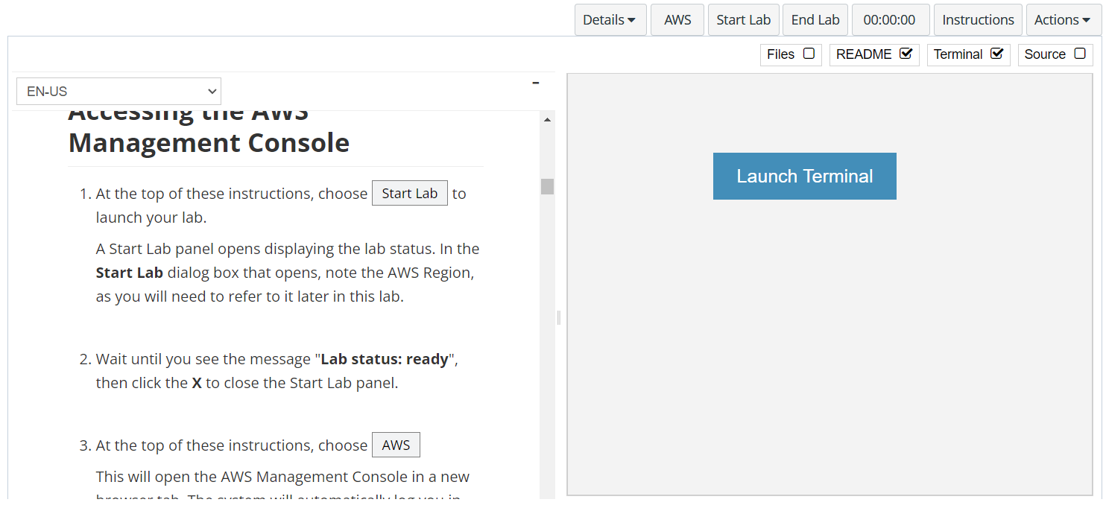
In aws labs click on start lab

Slide 4
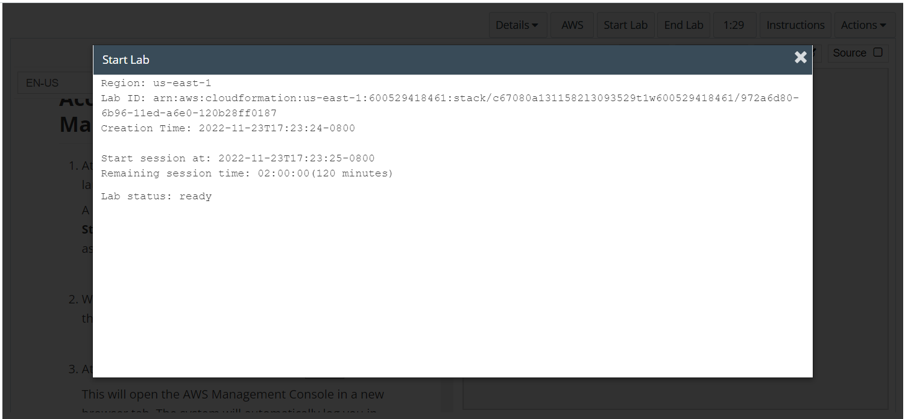
Wait to see lab ready status in the window then press x and click on aws to launch console

Slide 5
Task 1: Creating a public subnet

Slide 6
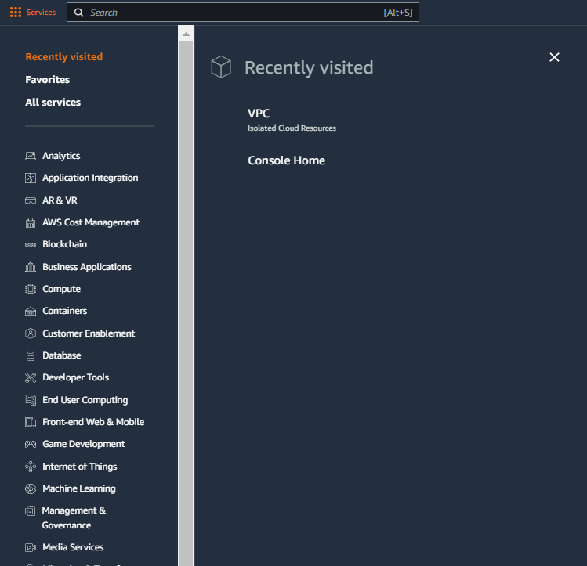
Select services and then click on VPC button
Click on the Services button
Click on the VPC button

Slide 7
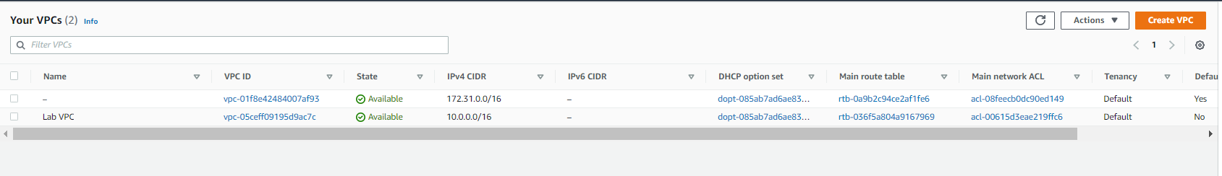
UNDER YOUR VPC’S YOU CAN SEE LAB VPC HAS BEEN CERATED

Slide 8
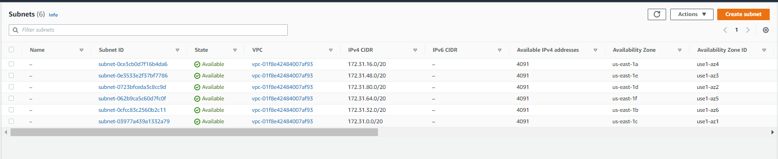
IN THE SUBNETS MENU CLICK ON CREATE SUBNETS BUTTON

Slide 9
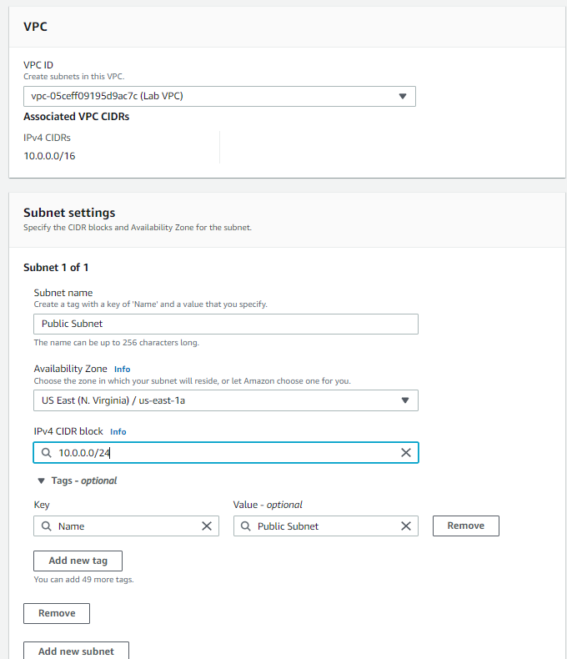
In the create subnet menu choose lab vpc and then select the settings as shown, click on create subnet button

Slide 10
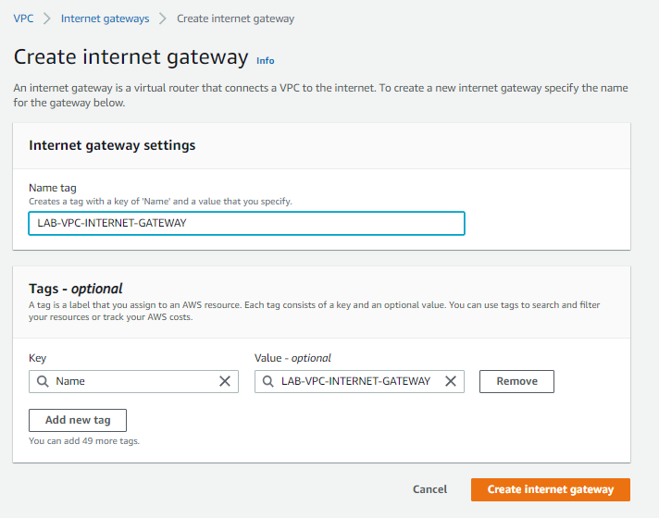
Go to internet gateway screen and click on create internet gateway, THEN ENTER THE GATEWAY DETAIL AS SHOW AND CLICK CREATE INTERNET GATEWAY BUTTON

Slide 11
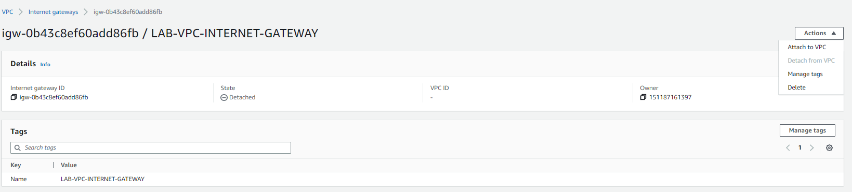
ONCE THE GATEWAY IS CREATED CLICK ON ACTIONS > ATTACH TO VPC AND THEN ATTACH IT TO LAB VPC

Slide 12
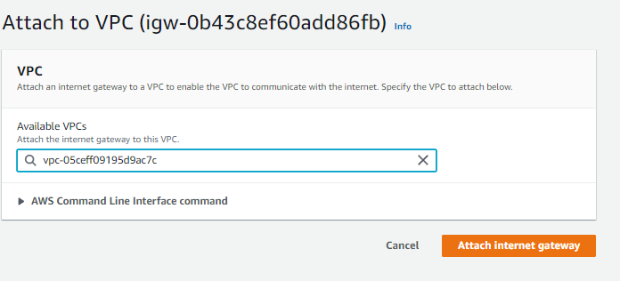
SELECT LAB VPC IN AVAILABLE VPC AND THEN CLICK ATTACH INTERNET GATEWAY

Slide 13
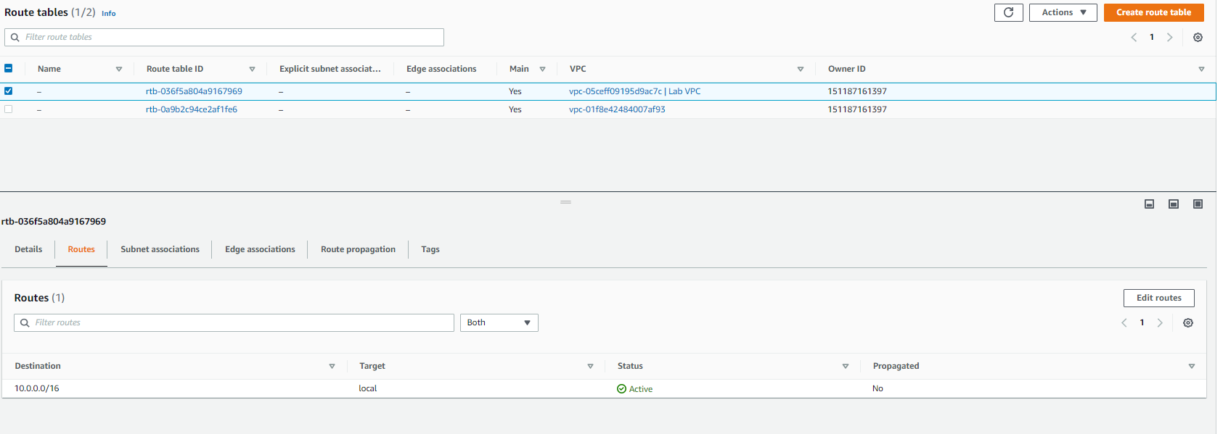
GO TO THE ROUTE TABLES MENU AND THEN SELECT THE TABLE ATTACHED WITH LAB VPC AND THEN EDIT ROUTE TO ADD TRAFFIC TO INTERNET GATEWAY FROM ANYWHERE

Slide 14
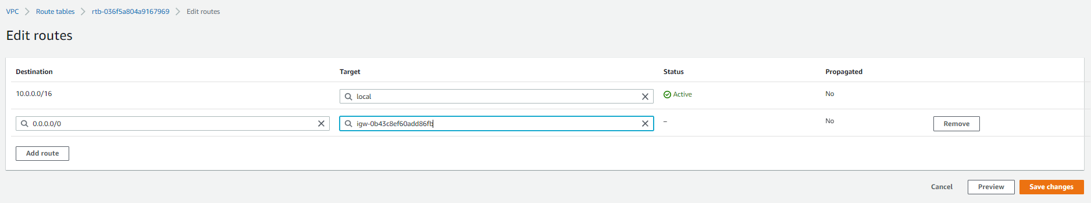
Add the route to internet gateway from 0.0.0.0 and click on save changes

Slide 15
Task 2: Creating a bastion host

Slide 16
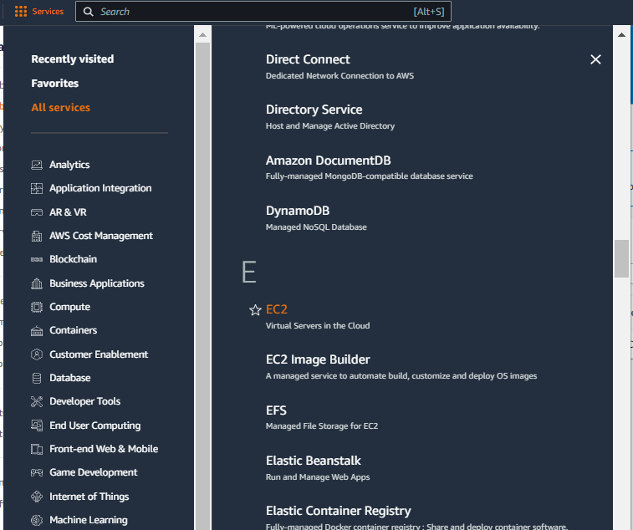
Select services and then click on EC2 button
Click on the Services button
Click on the EC2 button

Slide 17
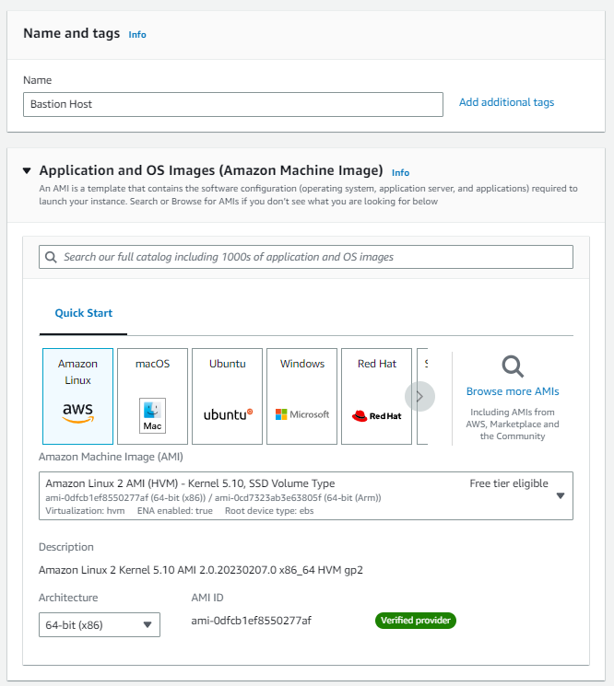
Start a new instance in the same region with the following properties

Slide 18
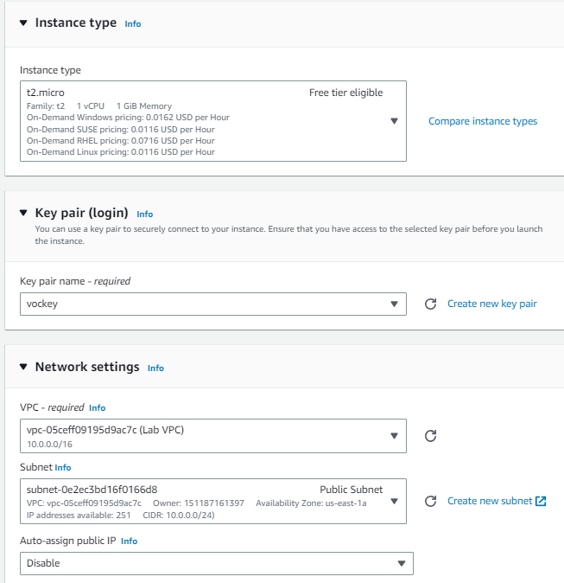
Set instance type as t2.micro, keypair as vockey and vpc as lab vpc with public subnet as shown

Slide 19
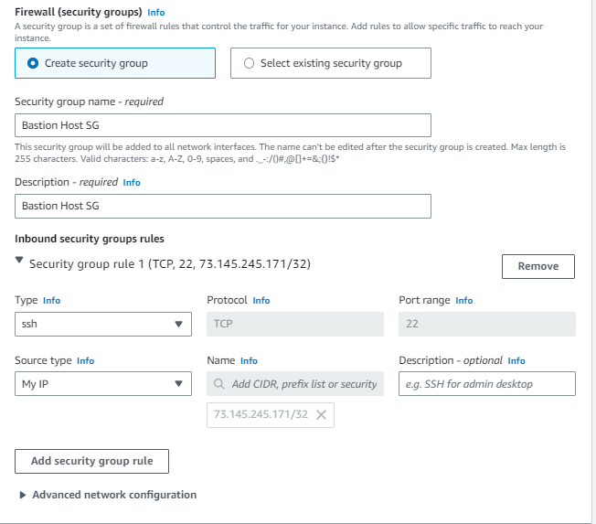
Create a security group with nane as bastion host sg and allow ssh access from port 22 from your IP AND THEN CLICK LAUNCH INSTANCE

Slide 20
Task 3: Allocating an Elastic IP address for the bastion host

Slide 21
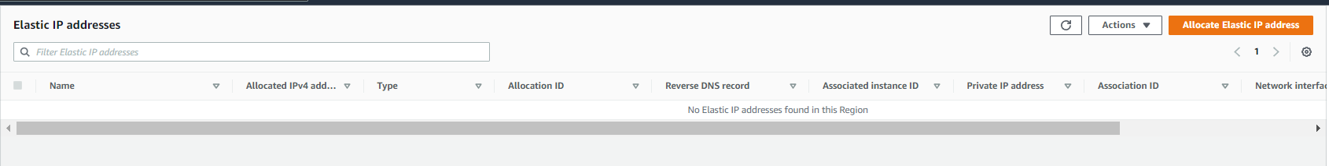
GO TO ELASTIC IP ADDRESSES AND CLICK ON ALLOCATE ELASTIC IP ADDRESS BUTTON

Slide 22
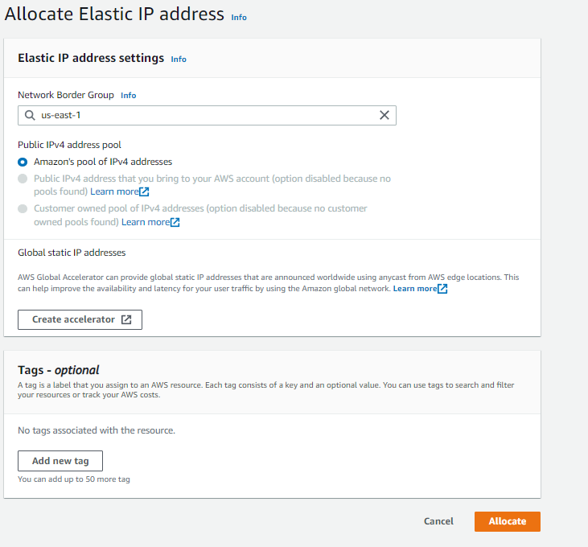
CLICK ON ALLOCATE FOR THE CORRECT REGION

Slide 23
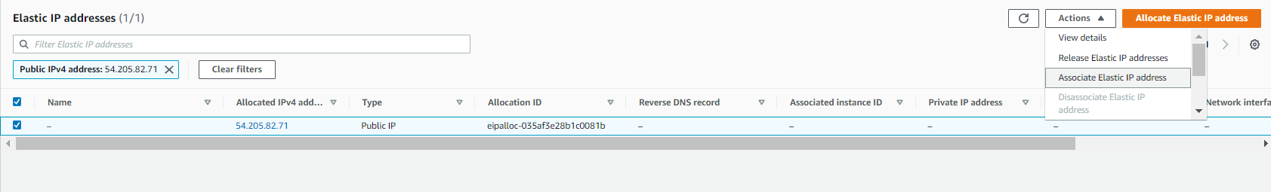
ONCE THE IP ADDRESS IS CREATED SELECT ASSOCIATE ELASTIC IP ADDRESS

Slide 24
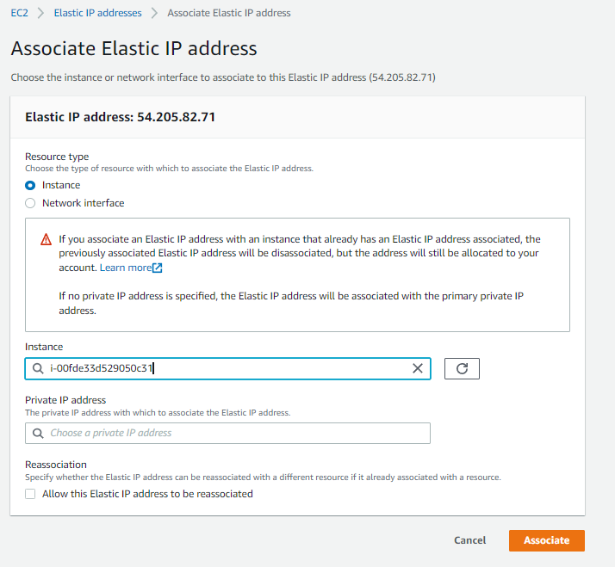
IN THE ASSOCIATE ELASTIC IP ADDRESS SCREEN SELECT INSTANCE AND THE BASTION HOST INSTANCE IN THE INSTANCE BOX BELOW AND CLICK ASSOCIATE

Slide 25
Task 4: Testing the connection to the bastion host

Slide 26
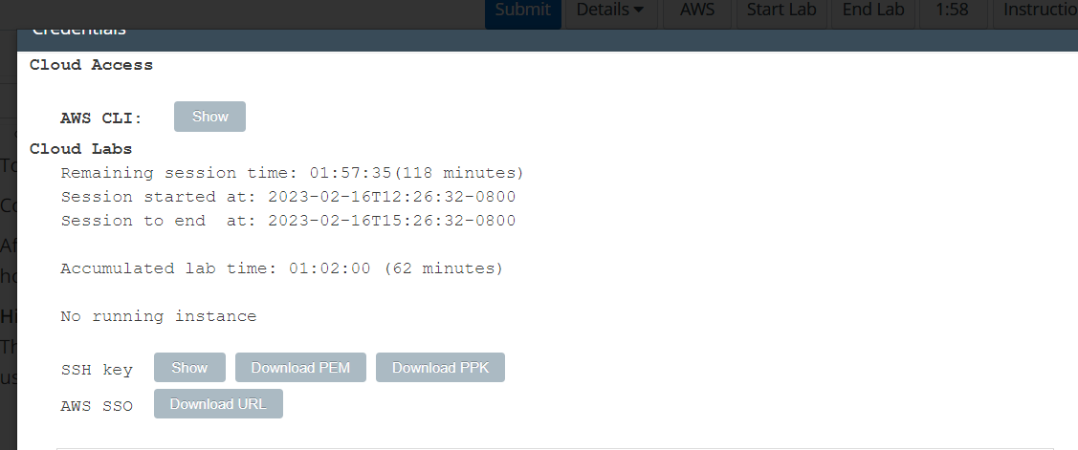
In aws labs select details > aws:show and then download the pem/ppk key based on the OS of your system

Slide 27
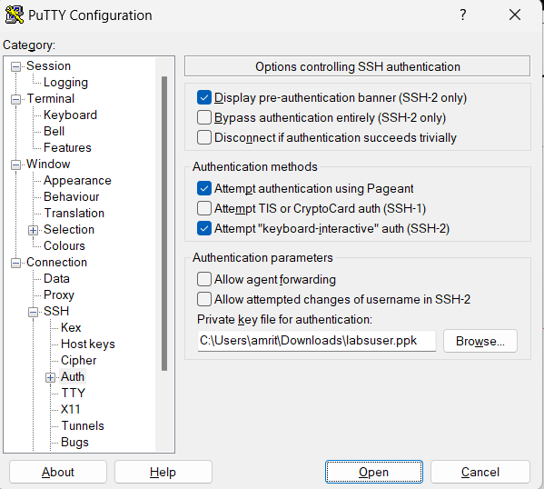
for loggin in with putty download the ppk file and then open putty > connections > ssh > auth and then browse for your ppk key

Slide 28
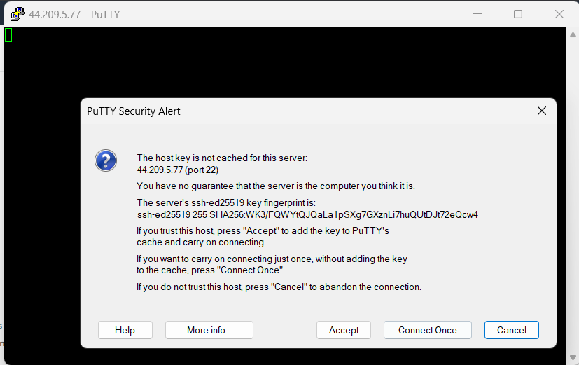
Go to session and add the elastic ip of the bastion host and click on open, then click accept and login with ec2-user

Slide 29
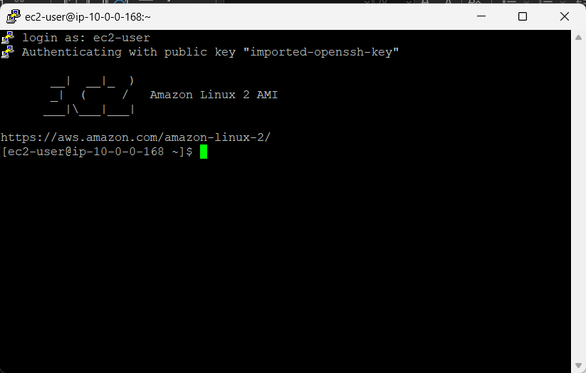
You should be able to login with ec2-user in the putty

Slide 30
Task 5: Creating a private subnet

Slide 31
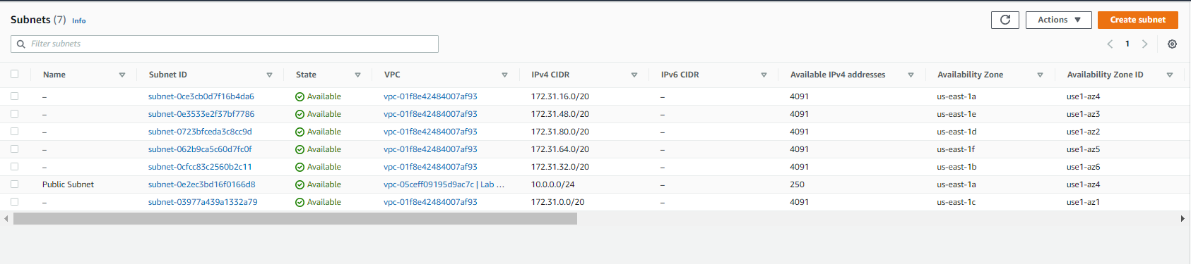
In vpc go to subnets menu and click on create subnet

Slide 32
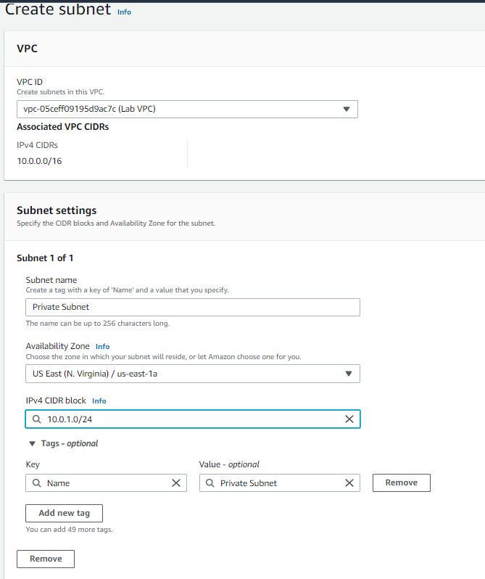
Under the create subnet menu select lab vpc and then under subnet settings select availability zone as the same as your public subnet and the ipv4 block as shown

Slide 33
Task 6: Creating a NAT gateway

Slide 34
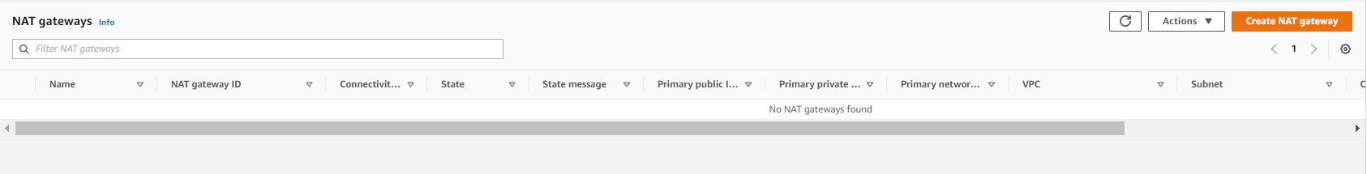
Go to nat gateway menu and then click on create nat gateway

Slide 35
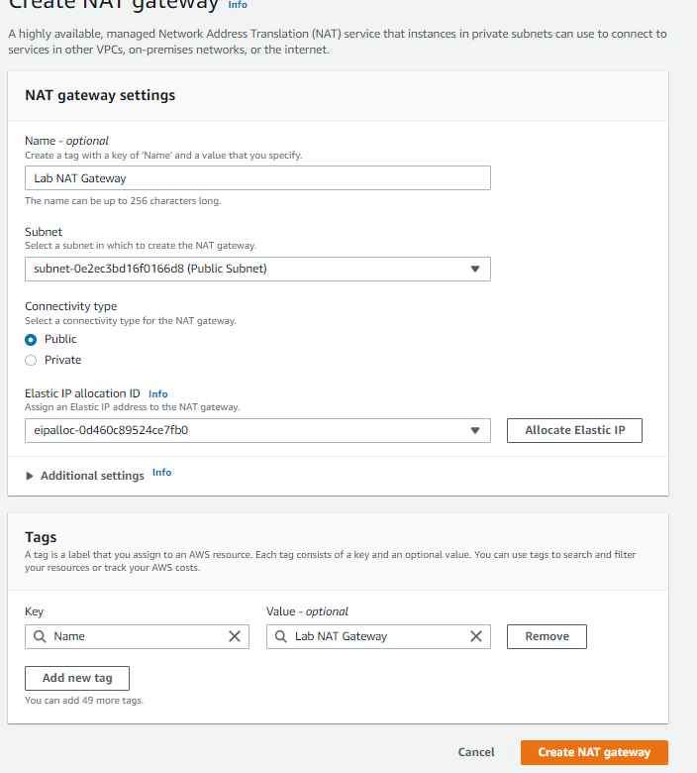
In the create NAT GATEWAY MENU, ENTER NAME AS SHOWN, SUBNET AS PUBLIC SUBNET AND THEN CLICK ON ALLOCATE ELASTIC IP TO GET AN ELASTIC IP ADDRESS AND THEN CLIK CREATE NAT GATEWAY

Slide 36
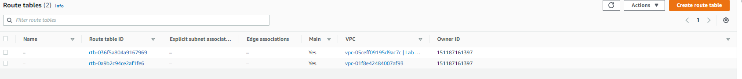
GO TO ROUTE TABLES AND CREATE A NEW ROUTE TABLE

Slide 37
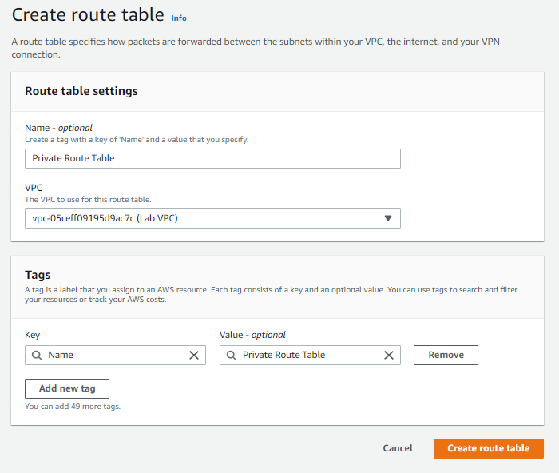
CREATE ROUTE TABLE WITH THE NAME AS PRIVATE ROUTE TABLE AND THEN SELECT LAB VPC

Slide 38
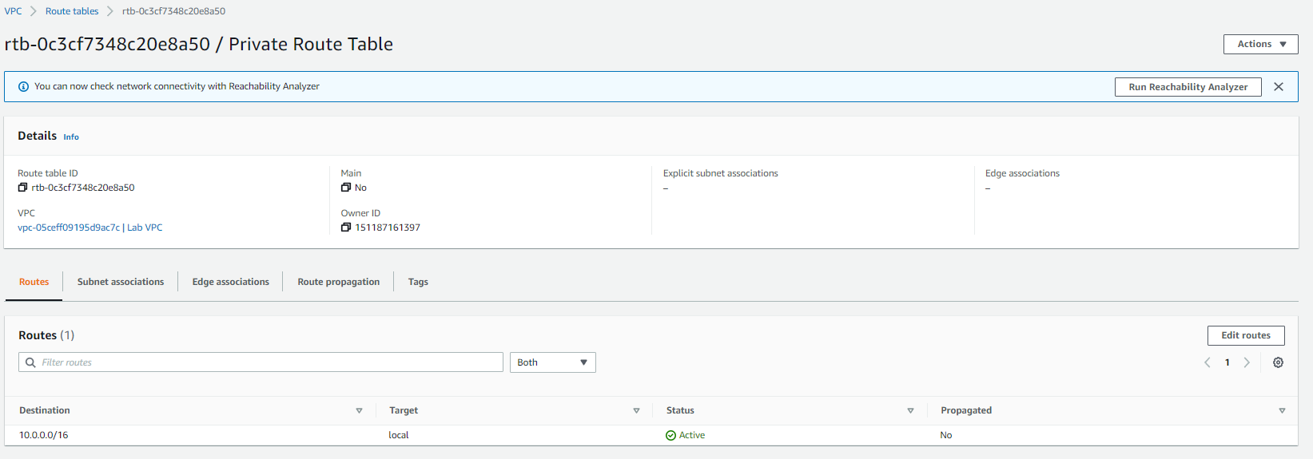
Edit the route table by clicking on edit routes

Slide 39
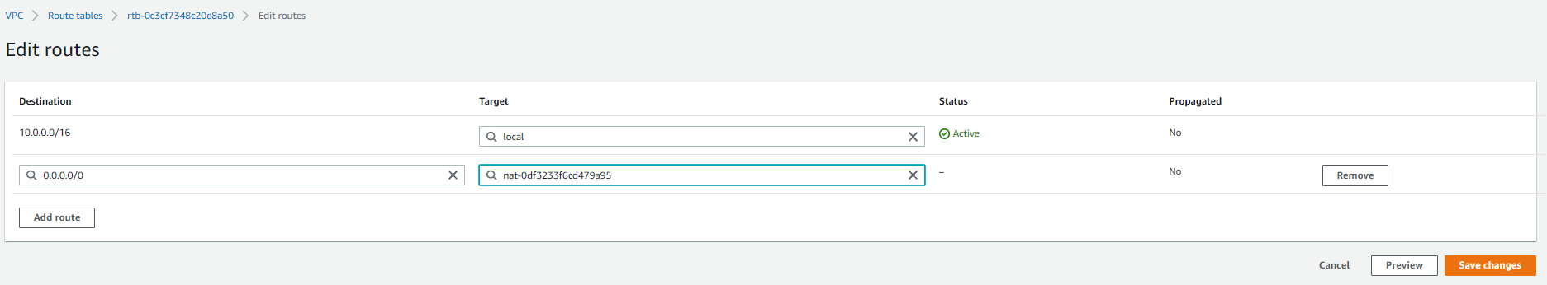
Add a route from 0.0.0.0 to nat gateway that you created and click save changes

Slide 40
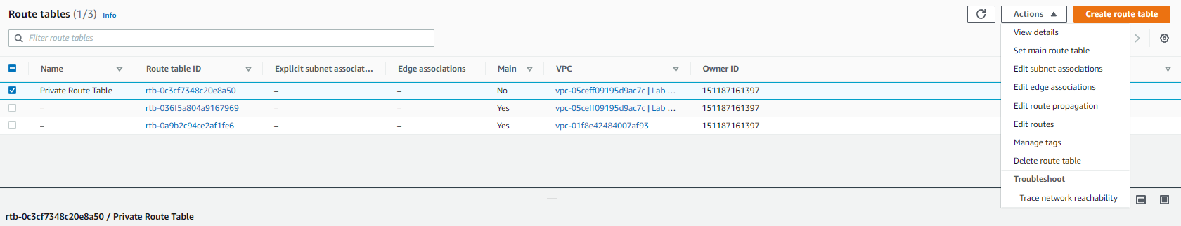
To attach the route table to the private subnet by selecting the route table and then click on action > edit subnet associations

Slide 41
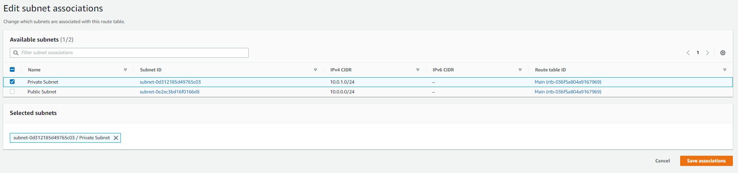
Under the edit subnet association select private subnet and then click on save associations

Slide 42
Task 7: Creating an EC2 instance in the private subnet

Slide 43
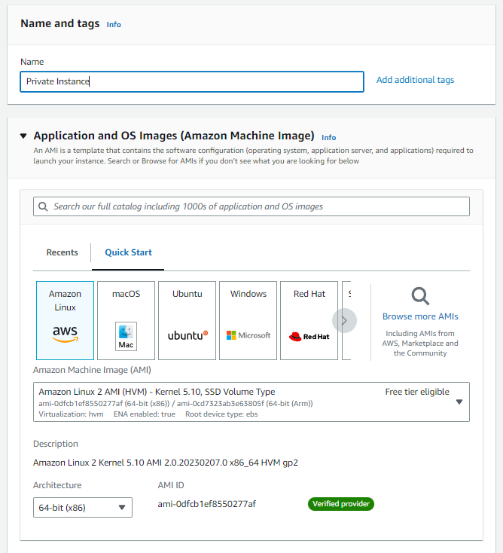
Create a new instance in the private subnet with the details as shown below

Slide 44
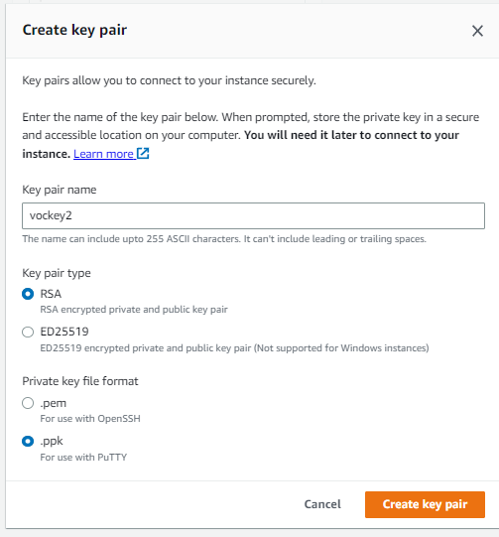
Create a new key pair called vockey2 and download the pem/ppk key

Slide 45
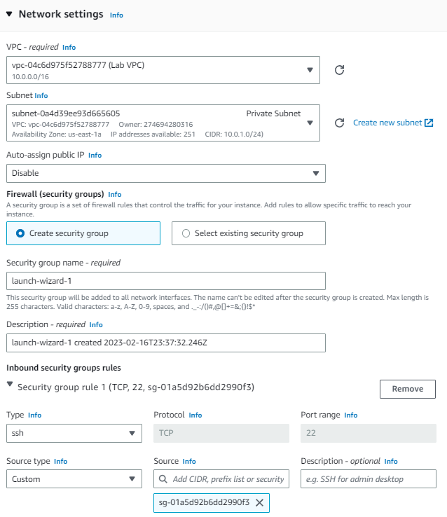
Under the network settings select lab vpc, subnet as private subnet and create a new security group which allows traffic from bastion host sg and then click on launch instance

Slide 46
Task 8: Configuring your SSH client for SSH passthrough

Slide 47
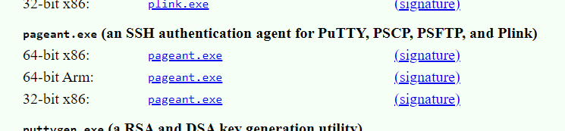
Download pageant.exe from the putty website

Slide 48
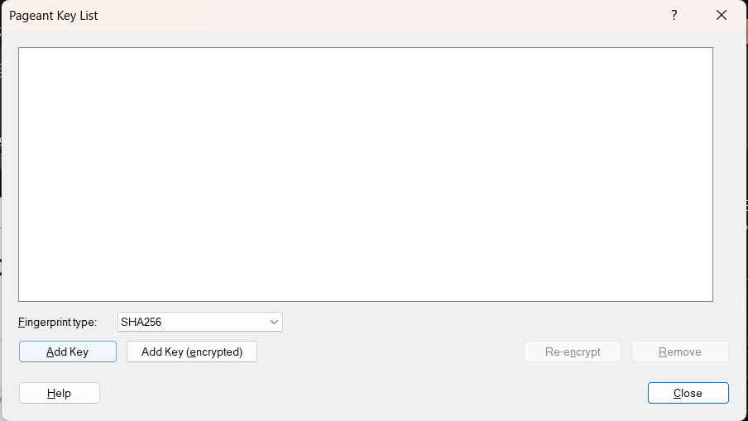
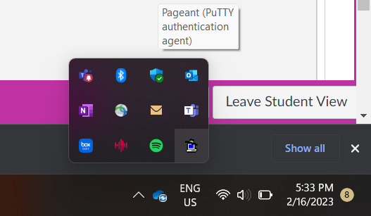
Double click on pageant icon in the windows tray and click on add key

Slide 49
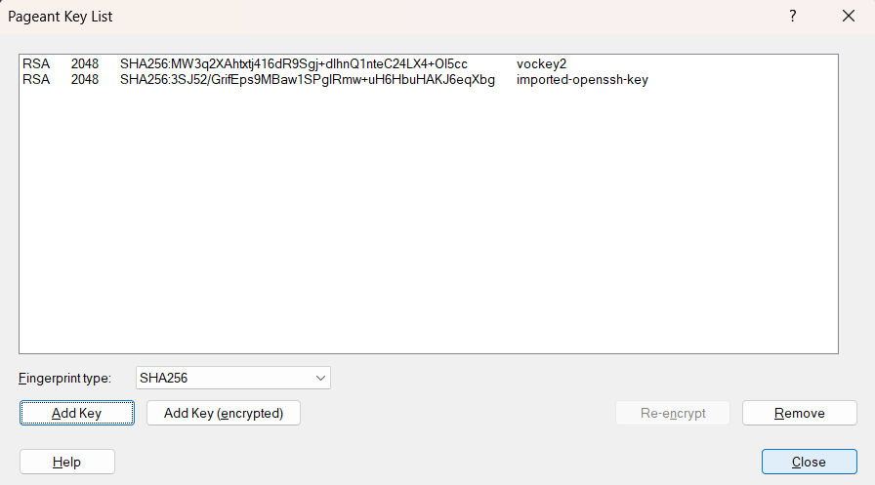
The pageant key list should look like the following, add labuser ppk key to the system, once the 2 keys are added then click close

Slide 50
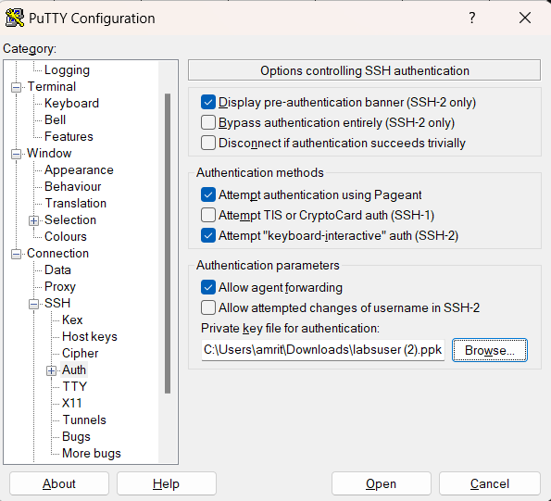
In putty select ssh > connections > auth and then select allow agent forwarding, under privatekey for authentication choose labuser key and click open

Slide 51
Task 9: Testing the SSH connection from the bastion host

Slide 52
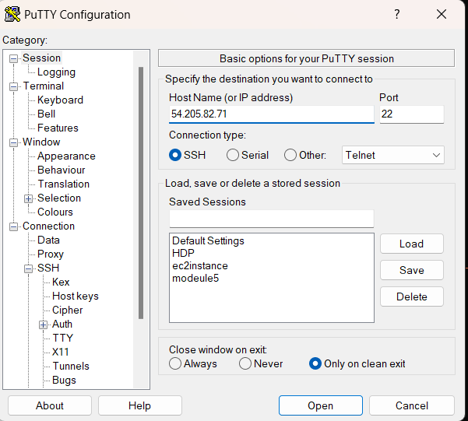
Connect to bastion host using putty as shown, enter the ip address and then click open

Slide 53
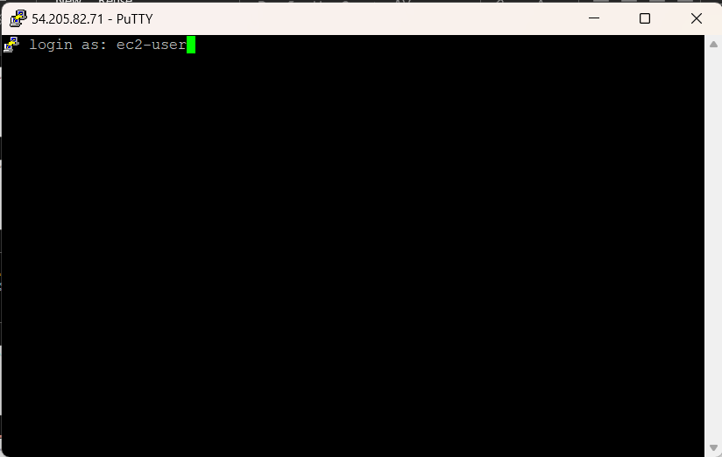
Login as ec2-user

Slide 54
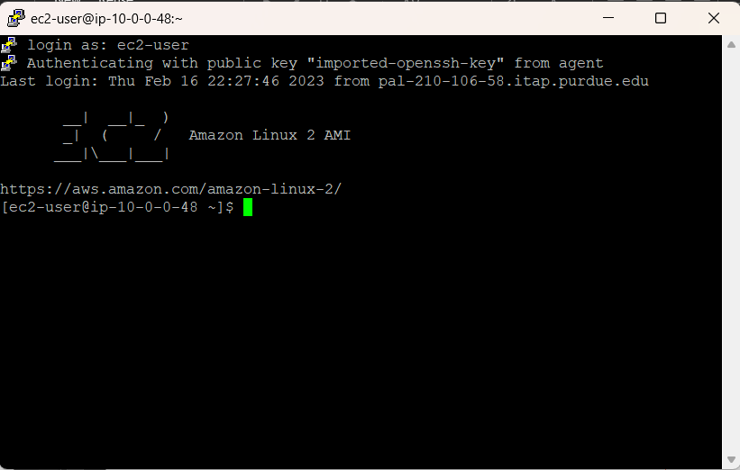
Connected to bastion host

Slide 55
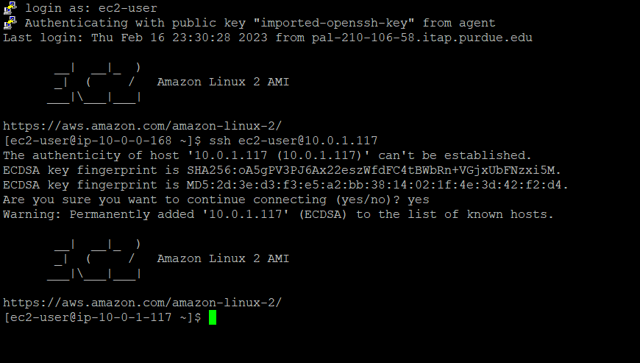
Connect to private instance from the bastion host

Slide 56
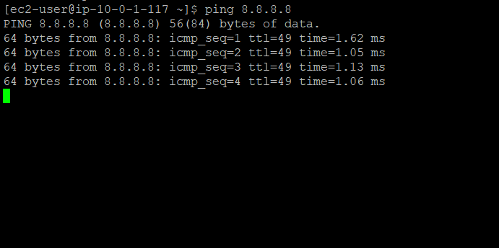
Try ping 8.8.8.8 to test internet connection of private instance, press ctrl+c to exit

Slide 57
Task 10: Creating a network ACL

Slide 58
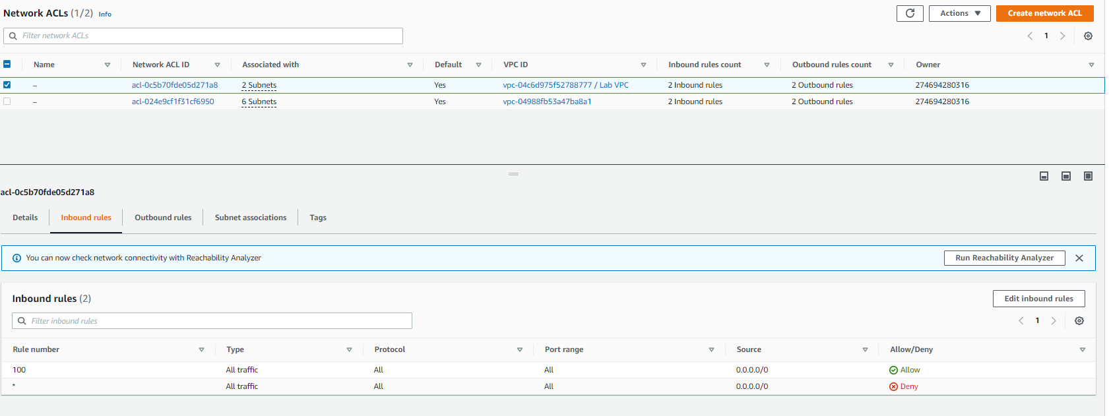
Inspect network acl of the lab vpc in the vpc menu under network acls section

Slide 59
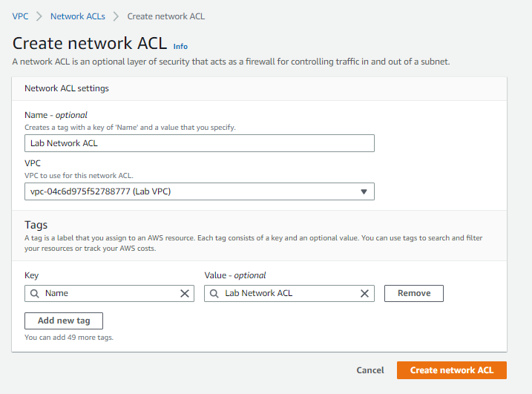
Click on create network acl and configure the following and click on create network acl

Slide 60
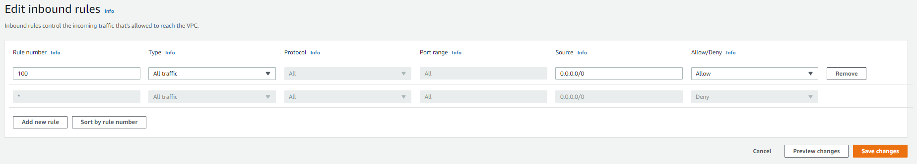
Click on inbound rule and then edit inbound rules and add the rule as shown and click on save changes

Slide 61
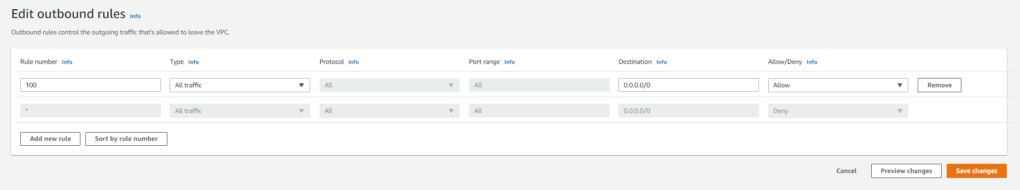
Click on outbound rule and then edit outbound rules and add the rule as shown and click on save changes

Slide 62

Neext click on actions > edit subnet associations

Slide 63

Select private click save changes

Slide 64
Task 11: Testing your custom network ACL

Slide 65

Launch a new ec2 instance with the following details

Slide 66

Instance type as t2.micro and key pair as vockey

Slide 67

Vpc should be lab vpc deployed in public subnet and the security group should allow icmp – ipv4 from the private instance security group, click on launch instance
Note: the security group for private instance will go as the source for test instance

Slide 68

Ping the test instance from the private instance using putty to see that the instance is responding

Slide 69

Modify the custom network ACL to deny all icmp ipv4 traffic from private ip of test instance

Slide 70

The putty console will not update with the ping to the private instance

Slide 71
THANK YOU
Amrit Singh

